Slide 1


Exploratory Analysis of the city of Madrid

Slide 2
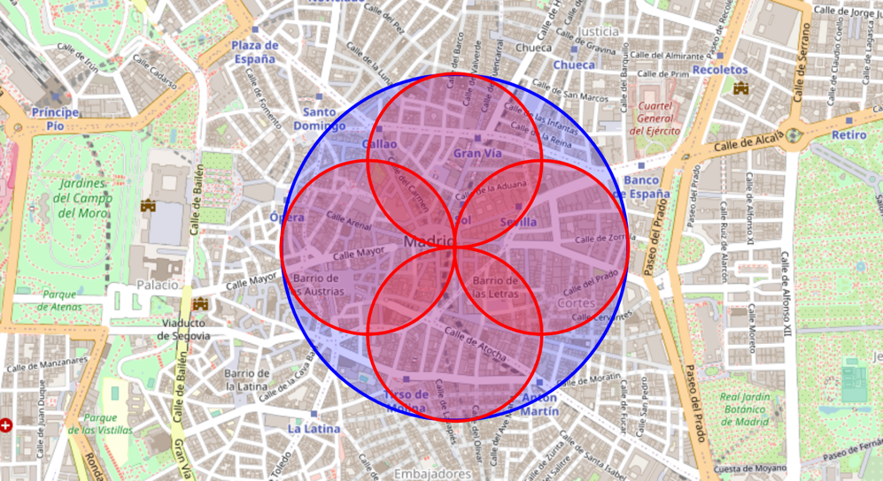
Area of Analysis(Aproximation)

Slide 3
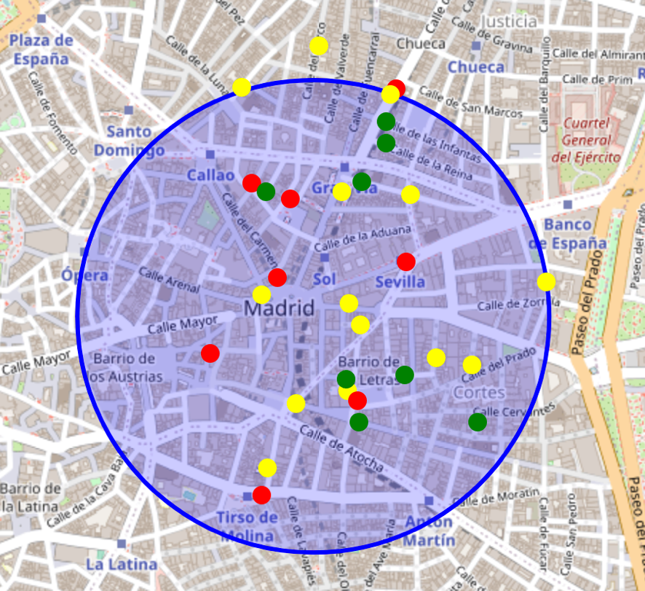
Restaurants clasified into high,middle, low rating

Slide 4
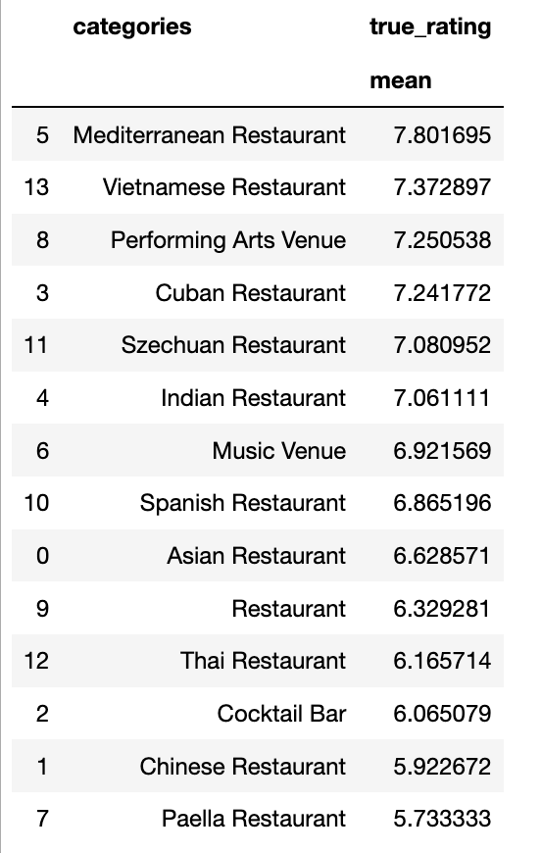
Average Rating per category

Slide 5
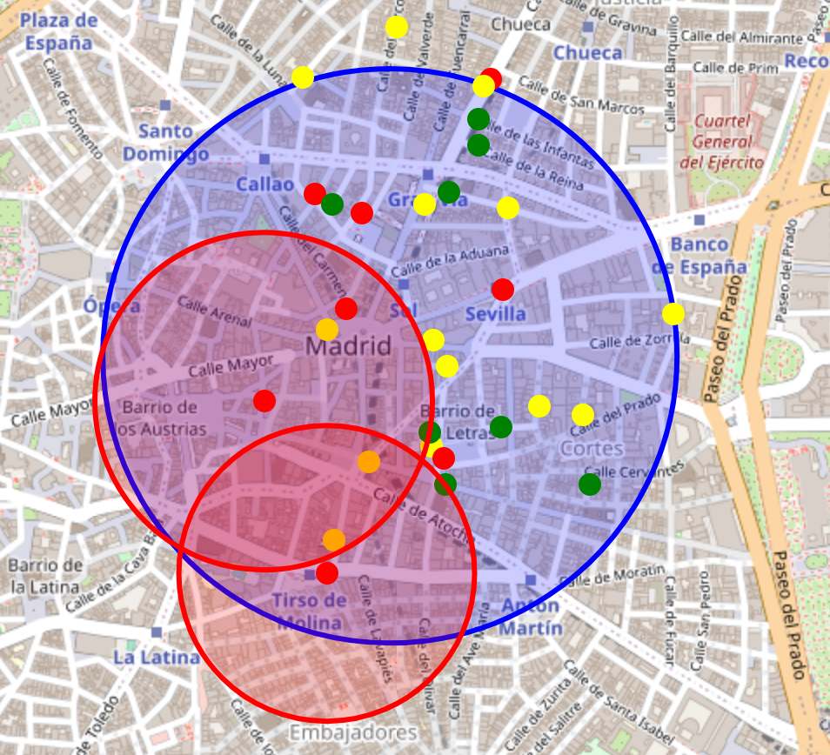
Candidates for Investment

